Slide 1



Masters Thesis: Stakeholder Chatbot for WICE Data
Internal AI Agent for Faster Data Clarification
Problem Today
Clarifying WICE data requires emails, meetings, and manual follow-ups, often taking hours or days.
Proposed Solution
An AI-powered chatbot that answers WICE data questions instantly using documented sources.
Target Users
R&D engineers, managers, product owners, executives, and internal staff.
Thesis Team
Deepa Krishnan
Punnoose Kozhuppakalam Thomas
Notes:
Introduce the motivation: recurring WICE-related questions slow teams down. Emphasize internal-only usage and focus on speed, consistency, and documentation-backed answers.
Problem : WICE requires manual human-to-human contact
Proposal : AI Agent that answers queries based on documentation and data
Target Users : All internal Stakeholders
Assumptions : Proper documentation

Slide 2



Why This Matters
From Human Dependency to Self-Service
Efficiency Gain
Reduces dependency on WICE team members for routine clarifications.
Faster Decisions
Stakeholders get answers in seconds while staying in their workflow.
Knowledge Consistency
Answers are grounded in documentation and data, not human memory.
Notes:
Reduce Human dependence and human error
Faster responses
Responses grounded to traceable documentation/data

Slide 3



Scope & Intent
Focused, Internal, and Extendable
Scope
Limited to WICE-related data, documentation, and governance queries.
Product Type
Proof of concept with a clear path to production readiness.
Access Model
Available internally via Microsoft Teams within the Sweden intranet.
Notes:
Limited to WICE related documented data
This is just proof of concept but ready for expansion towards product release
Available only in Sweden, and only for Volvo Accounts through Microsoft Teams

Slide 4


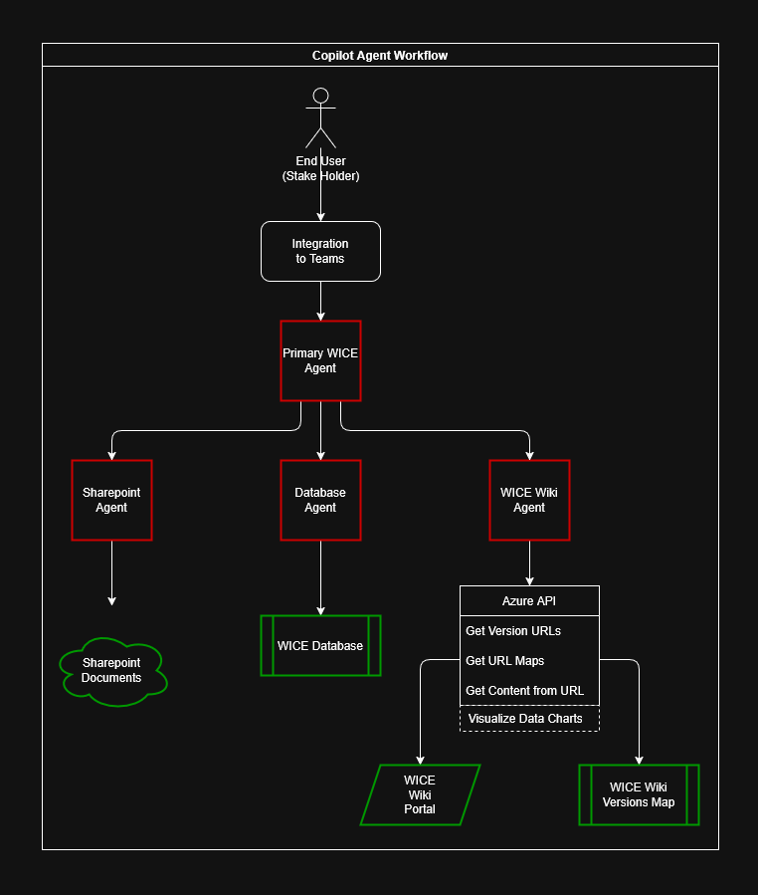
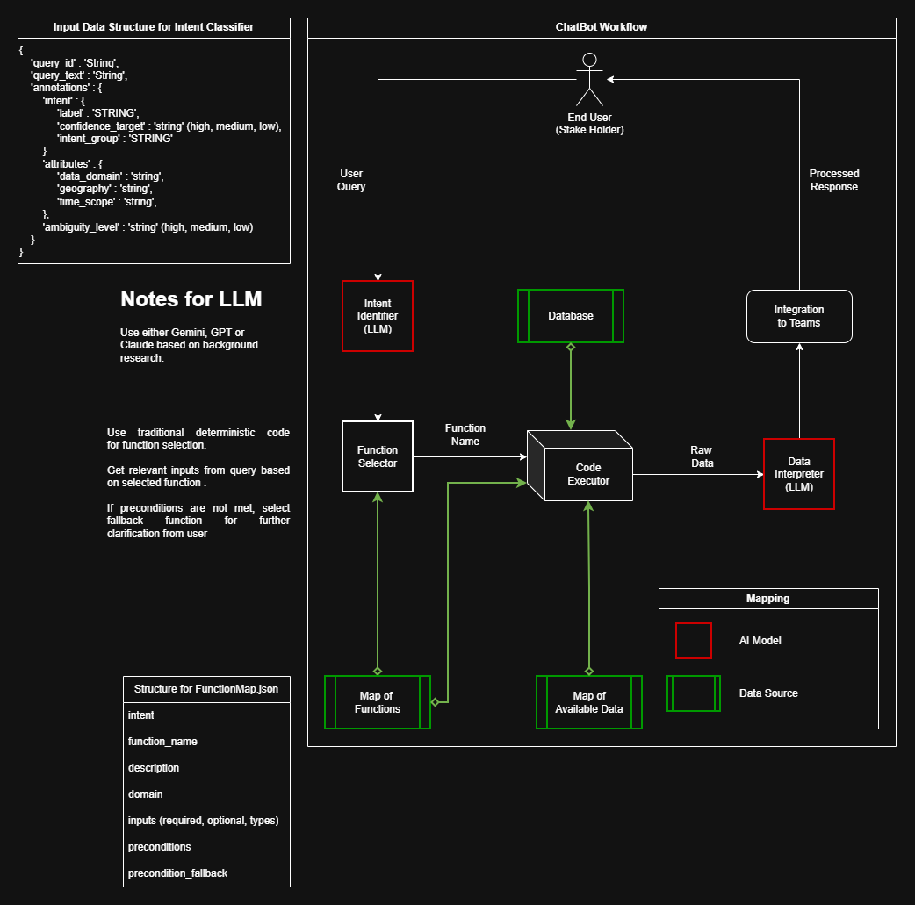
Comparative Workflow Strategies
Copilot No‑Code vs Traditional Agentic Approaches
Proposed Copilot No‑Code Workflow
Proposed Traditional Agentic Workflow
Anticipated Strategic Trade‑offs
Posits that the No‑Code path could deliver accelerated prototyping, streamlined maintenance, and centralized governance.
The Agentic path may provide maximal extensibility for niche edge‑cases.
Decision criteria would hinge on project timelines, required custom logic, and projected long‑term operational budgets.
Notes:
Agentic System : Best for academic submission as a Thesis paper
Copilot System : Best for current internal environment with minimal changes
Comparison stands as a baseline on which is better in the production pipeline. Helps weigh options.

Slide 5
Copilot No-Code Chatbot Workflow
Comparative Workflow Strategies
Copilot No‑Code vs Traditional Agentic Approaches
Primary Agent : Where the data might be, what agent to call to get the data, does any of the received data from one agent require further clarification/cross-references from other agents/documentation
SharePoint Agent : What document to fetch, how to interpret the document
Database Agent : How much of the data to show, what query to use to get this data
WICE Wiki Agent : What sub-URL(s) from the WICE Wiki page would best answer the query, invokes the required endpoint functions
Proposed Copilot No‑Code Workflow
Proposed Traditional Agentic Workflow
Anticipated Strategic Trade‑offs
Posits that the No‑Code path could deliver accelerated prototyping, streamlined maintenance, and centralized governance.
The Agentic path may provide maximal extensibility for niche edge‑cases.
Decision criteria would hinge on project timelines, required custom logic, and projected long‑term operational budgets.
Notes:
Primary Agent : Where the data might be, what agent to call to get the data, does any of the received data from one agent require further clarification/cross-references from other agents/documentation
SharePoint Agent : What document to fetch, how to interpret the document
Database Agent : How much of the data to show, what query to use to get this data
WICE Wiki Agent : What sub-URL(s) from the WICE Wiki page would best answer the query, invokes the required endpoint functions

Slide 6
Comparative Workflow Strategies
Copilot No‑Code vs Traditional Agentic Approaches
Proposed Copilot No‑Code Workflow
Proposed Traditional Agentic Workflow
Anticipated Strategic Trade‑offs
Posits that the No‑Code path could deliver accelerated prototyping, streamlined maintenance, and centralized governance.
The Agentic path may provide maximal extensibility for niche edge‑cases.
Decision criteria would hinge on project timelines, required custom logic, and projected long‑term operational budgets.
Notes:
Agentic System : Best for academic submission as a Thesis paper
Copilot System : Best for current internal environment with minimal changes
Comparison stands as a baseline on which is better in the production pipeline. Helps weigh options.

Slide 7
Traditional Agentic Chatbot Workflow
Comparative Workflow Strategies
Copilot No‑Code vs Traditional Agentic Approaches
LLM Agent 1 is used to identify what function to run
LLM Agent 2 interprets the obtained result
Everything else is hard coded with deterministic logic
Every data obtained is traceable and can be backed with proof
Proposed Copilot No‑Code Workflow
Proposed Traditional Agentic Workflow
Anticipated Strategic Trade‑offs
Posits that the No‑Code path could deliver accelerated prototyping, streamlined maintenance, and centralized governance.
The Agentic path may provide maximal extensibility for niche edge‑cases.
Decision criteria would hinge on project timelines, required custom logic, and projected long‑term operational budgets.
Notes:
LLM Agent 1 is used to identify what function to run
LLM Agent 2 interprets the obtained result
Everything else is hard coded with deterministic logic
Every data obtained is traceable and can be backed with proof

Slide 8



High-Level Architecture
Multi-Agent Copilot-Based Design
Top-Level Agent
Primary WICE agent orchestrates queries across specialized agents.
Source Agents
Dedicated agents for Wiki, SharePoint documentation, and databases.
Teams Integration
End users interact directly through Microsoft Teams.
Notes:
Primary WICE agent orchestrates queries across specialized agents
Dedicated agents for Wiki, SharePoint documentation, and databases.
End users interact directly through Microsoft Teams.

Slide 9



Data Sources & Governance
Trusted Internal Knowledge
Primary Sources
Data Freshness
Metadata and collected-data info is near real-time;
Historical access via request.
Governance Aware
Designed to respect access control and data ownership.
SharePoint documents
WICE databases
public Wiki, and URL maps.
Notes:
Reassure stakeholders that this system does not bypass governance and only surfaces what users are allowed to see.

Slide 10


Status & Next Steps
From Ideation to Working Prototype
Current Phase
Ideation and development loop with architecture defined.
Immediate Needs
Azure API resources
SharePoint access
Database permissions.
Future Direction
Evaluate alternative agentic workflow and extend toward production.
Notes:
Close with where the project stands today and what support is needed to move forward.

Slide 11
Thank you

